Slide 1

Digital Portfolio
STUDENT NAME: Vimal raj.G
REGISTER NO AND NMID: 222402603 and 25D429E3168E9F0B74545DAEA9F157D2
DEPARTMENT: B.Sc Computer science with Data science
COLLEGE: Prince shri venkateshwara arts and science college /Madras University
1
Notes:
1

Slide 2

PROJECT TITLE
Graduate portfolio website
2

Slide 3



AGENDA
Problem Statement
Project Overview
End Users
Tools and Technologies
Portfolio design and Layout
Features and Functionality
Results and Screenshots
Conclusion
Github Link
3/21/2024 Annual Review
3

Slide 4

PROBLEM STATEMENT
Students and job seekers often rely only on resumes to showcase skills.Traditional resumes lack interactivity and creativity.Recruiters find it hard to assess true potential.
4

Slide 5

PROJECT OVERVIEW
Basic PortfolioThis project is a simple personal website about me. It includes sections like About Me, Education, Hobbies, Skills, and Contact with my profile image. The goal is to give a neat introduction to my academic journey.
5

Slide 6

WHO ARE THE END USERS?
The end users of my digital portfolio are recruiters and hiring managers who can easily access my profile, skills, and achievements to evaluate me for internships or job opportunities.
6

Slide 7

TOOLS AND TECHNIQUES
HTML → Used to create the structure of the portfolio (headings, paragraphs, sections).
CSS → Used to add design, colors, and styling.
GitHub Pages → Used to host the portfolio online and share it easily.
7

Slide 8
POTFOLIO DESIGN AND LAYOUT
Home → A welcome message with my name and profile image.
About Me → A short paragraph about myself.
Skills → A simple bullet or numbered list of my skills.
Education → Details in table format or plain text (School, College, Year).
Hobbies → A simple list of hobbies.
Contact → My phone number, email, and address in plain text.
Responsive → On mobile, everything stacks in a single column.
8

Slide 9
FEATURES AND FUNCTIONALITY
Navigation bar with smooth scrolling – helps to move across sections easily.Project showcase with details – highlights my academic and personal works.Interactive hover effects – makes the portfolio engaging to explore.Responsive design – adjusts neatly on all devices.Organized layout – keeps sections clear and simple.

Slide 10
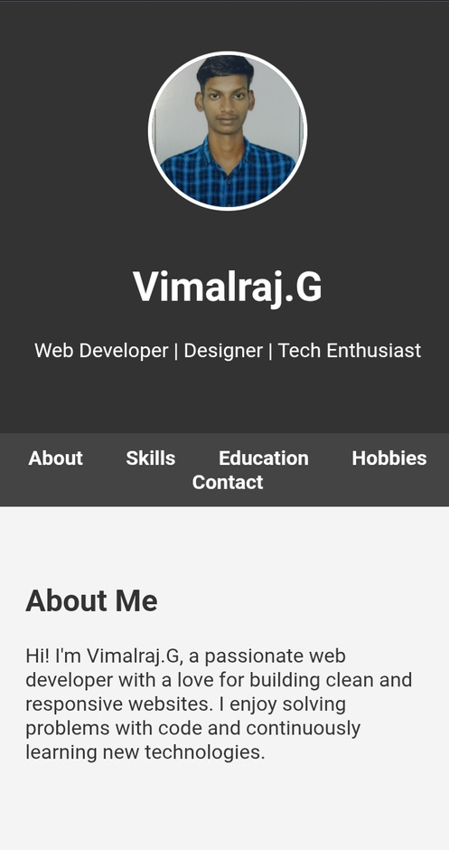
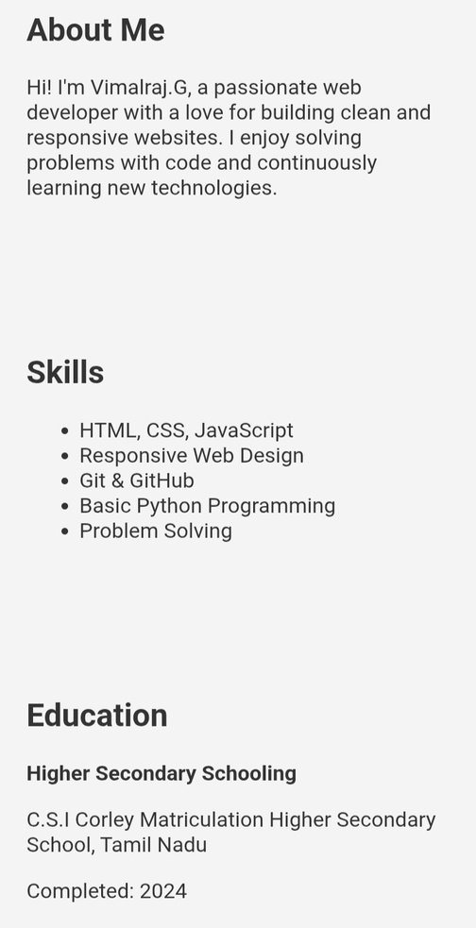

RESULTS AND SCREENSHOTS
3/21/2024 Annual Review
10

Slide 11
CONCLUSION
My portfolio is a simple way to showcase myself.It includes my education, skills, hobbies, and profile.The design is neat and easy to understand.It works on all devices with a responsive layout.This portfolio reflects my learning and growth.
11

